Slide 1
CS35L – Fall 2018
Slide set: | 8.2
Slide topics: | Dynamic linking
Assignment: | 8

Slide 2
GCC Flags
-fPIC: Compiler directive to output position independent code, a characteristic required by shared libraries.
-llibrary: Link with "liblibrary.a”
  Without -L to directly specify the path, /usr/lib is used.
-L: At compile time, find the library from this path.
-Wl,rpath=.: -Wl passes options to linker.
  -rpath at runtime finds .so from this path.
-c: Generate object code from c code but do not link
-shared: Produce a shared object which can then be linked with other objects to form an executable.
https://gcc.gnu.org/onlinedocs/gcc/Link-Options.html#Link-Options
Notes:
PIC: Position Independent Code means that the generated machine code is not dependent on being located at a specific address in order to work.
E.g. jumps would be generated as relative rather than absolute.
-Wl,option

Slide 3
Creating static and shared libs in GCC
●
mymath.h
●
mul5.c
●
add1.c
#ifndef MY_MATH_H
#include "mymath.h"
#include "mymath.h"
#define MY_MATH_H
void mul5(int *i)
void add1(int *i)
void mul5(int *i);
{
{
void add1(int *i);
*i *= 5;
*i += 1;
#endif
}
}
gcc -c mul5.c -o mul5.o
gcc -c add1.c -o add1.o
ar -cvq libmymath.a mul5.o add1.o → (static lib)
gcc -shared -fpic -o libmymath.so mul5.o add1.o → (shared dynamic lib)
http://www.yolinux.com/TUTORIALS/LibraryArchives-StaticAndDynamic.html

Slide 4
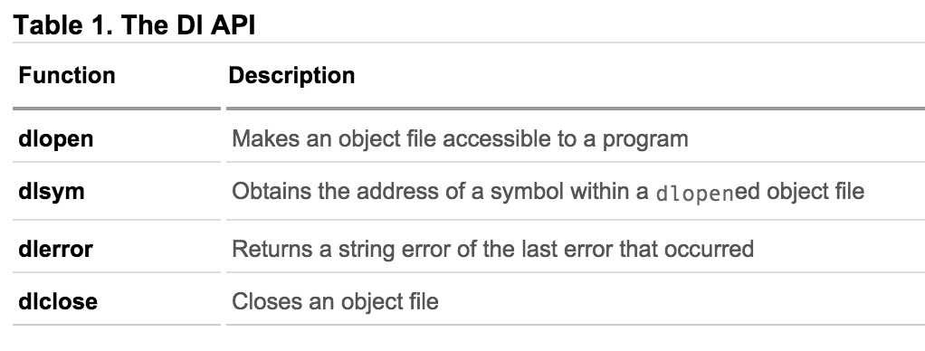
How are libraries dynamically loaded?

Slide 5
Dynamic loading
#include <stdio.h>
#include <dlfcn.h>
int main(int argc, char* argv[]) {
int i = 10;
void (*myfunc)(int *); void *dl_handle;
char *error;
dl_handle = dlopen("libmymath.so", RTLD_LAZY);//RTLD_NOW
if(!dl_handle) {
printf("dlopen() error - %s\n", dlerror()); return 1;
}
//Calling mul5(&i);
myfunc = dlsym(dl_handle, "mul5"); error = dlerror();
if(error != NULL) {
printf("dlsym mul5 error - %s\n", error); return 1;
}
myfunc(&i);
//Calling add1(&i);
myfunc = dlsym(dl_handle, "add1"); error = dlerror();
if(error != NULL) {
printf("dlsym add1 error - %s\n", error); return 1;
}
myfunc(&i);
printf("i = %d\n", i);
dlclose(dl_handle);
return 0;
}
Copy the code into main.c gcc main.c -o main -ldl
You will have to set the environment variable LD_LIBRARY_PATH to
include the path that contains libmymath.so
●
●
●
Notes:
-ldl: Libdl.so

Slide 6
Attributes of Functions
Used to declare certain things about functions called in your program
  Help the compiler optimize calls and check code
Also used to control memory placement, code generation options or call/return conventions within the function being annotated
Introduced by the attribute keyword on a declaration, followed by an attribute specification inside double parentheses
Reference: https://gcc.gnu.org/onlinedocs/gcc-3.1/gcc/Function-Attributes.html

Slide 7
Attributes of Functions
__attribute__ ((__constructor__))
  Is run when dlopen() is called
__attribute__ ((__destructor__))
  Is run when dlclose() is called
Example:
  __attribute__ ((__constructor__))
  void to_run_before (void) {
  printf("pre_func\n");
  }

Slide 8
Homework 8
Split randall.c into 4 separate files
Stitch the files together via static and dynamic linking to create the program
randmain.c must use dynamic loading, dynamic linking to link up with randlibhw.c and randlibsw.c (using randlib.h)
Write the randmain.mk makefile to do the linking

Slide 9
Homework 8
randall.c outputs N random bytes of data
  Look at the code and understand it
    main function
      Checks number of arguments (name of program, N)
      Uses helper function to check for HW support
      Uses helper functions to generate random number using HW/SW
    Helper functions that check if hardware random number generator is available, and if it is, generates number
      HW RNG exists if RDRAND instruction exists
      Uses cpuid to check whether CPU supports RDRAND (30th bit of ECX register is set)
    Helper functions to generate random numbers using software implementation (/dev/urandom)

Slide 10
Homework 8
Divide randall.c into dynamically linked modules and a main program. Don’t want resulting executable to load code that it doesn't need (dynamic loading)
randall.c = randcpuid.c + randlibhw.c + randlibsw.c + randmain.c
    randcpuid.c: contains code that determines whether the current CPU has the RDRAND instruction. Should include randcpuid.h and include interface described by it.
    randlibhw.c: contains the hardware implementation of the random number generator. Should include randlib.h and implement the interface described by it.
    randlibsw.c: contains the software implementation of the random number generator. Should include randlib.h and implement the interface described by it.
    randmain.c: contains the main program that glues together everything else. Should include randcpuid.h (as the corresponding module should be linked statically) but not randlib.h (as the corresponding module should be linked after main starts up). Depending on whether the hardware supports the RDRAND instruction, this main program should dynamically load the hardware-oriented or software-oriented implementation of randlib.

Slide 11
Homework 8 – randmain.mk
Create shared libraries
  randlibsw.o : -fPIC, -c and other existing options
  randlibhw.o : -fPIC, -c and other existing options
  randlibsw.so : -shared option
  randlibhw.so: -shared option
Create library for static linking – 2 options
  randcpuid.o: -c option, or
  ar command to create an archive of static libraries
Create object file for randmain
  randmain.o: -c option
Build randmain
  randmain: -ldl -Wl,-rpath=${PWD}
  If you used ar to create static library, use –lstaticlibrary option to statically link the library and optionally use –L option to specify the path for the statically linked library

